Slide 1
English for Today
Dakhil Class 9
unit 2 lesson 3

Slide 2
SS will be able to
Talk about the picture
Discuss with a partner about his/her feeling
Read a letter and make a list
Write about the problems of sharing accommodation

Slide 3
T will ask SS to write at least 5 action words or verb words that start with ‘s’
Vocabulary activity
T may invite 2/3 SS to the front and ask them to write words from their lists on the board
T will check the words with the whole class
T will give focus on the word ‘share’

Slide 4
?

Slide 5
What do you think about the pictures?

Slide 6
What are the two foreigners doing?

Slide 7
How can we make the world peaceful?

Slide 8
T will ask SS to talk about some pictures in pairs.
T may help SS by providing vocabulary

Slide 10
T may elicit SS’ idea on table manners, food habit etc.

Slide 11
Visualize a picture that describes
our family dining together

Slide 12
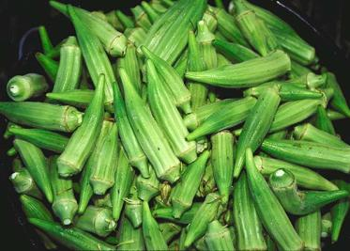

Slide 13
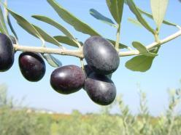

Slide 14
Practice on the use of prepositions

Slide 15
See and say what the children are doing

Slide 17
If a guest comes to your house to stay how do you feel?
Happy
Sad
Angry
Shy
Gloomy
Excited
But Sofia had a different experience………..

